Slide 1

Used Car Market Analysis
How much is my car worth? Which cars are good investments?

Slide 2
Used Car Price Factors
More shoppers today are likely to cite reliability (41% vs. 35% in 2022), finding a vehicle that fits their budget (40% vs. 33% in 2022), and expected costs (26% vs. 21% in 2022) as the most important factors in selecting a vehicle… with 89% saying they’d be willing to switch models and 69% open to switching brands.
— Car Guru Consumer Preferences Survey

Slide 3
Used Car Price Factors
Context: It can be difficult to identify a specific price for every vehicles depending on the mileage, trim level, and other varying features
Criteria for Success: Create a regression model for price with an error of $2000 or less per car
Scope: Identify specific models that retain value more or less than the competition
Constraints: Lack of organized vehicle reference data, imbalanced used car listings
Stakeholders: Car Dealers such as CARVANA, Car Buyers, Manufacturers
Data Sources: Craigslist car listings. Consumer reporting websites such as Edmunds & KellyBlueBook to supply supplemental car information

Slide 4
Data
400,000 Used Vehicles Listings Craigslist (Feb 2021) - Kaggle
Columns: manufacturer, model, cylinders, transmission, drive, title status, fuel type, size, type, condition, paint color, VIN, description, state, region, latitude, longitude, odometer, price
Challenges
#1: User Entered Data
Incorrect information: 8 cylinder cars listed as 6 cylinders
Identical values entered differently. Ex: ‘3.6L LT’ vs. ‘LT 3.6’ vs. ‘LT’
#2: No Sale Price
Only Listed Price so there is more variance
#3: Duplicate Car Listings

Slide 5
VIN Decoder from NHTSA.gov
Verifies unique vehicle: Removes Duplicates, avoiding skewed predictions
Organizes Car Features:
Make
Model
Year
Cylinders
Engine Size - 3.0L Engine, 4.6L Engine, etc.
Fuel Type - Gasoline, Hybrid, Diesel
BodyClass - Sedan, Coupe, Convertible, Pickup, Van, Cargo Van, SUV, MPV
VehicleType - Truck, Car
Gross Vehicle Weight Rating (GVWR)
Downside: number of unique listings reduced to 93,301 TODO: figure out # of duplicates,dropped,

Slide 6
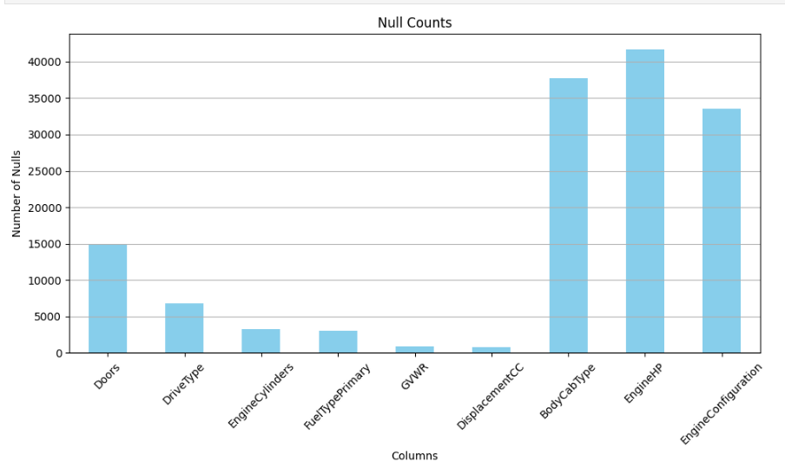
Imputations
DisplacementCC: Gave a lot of info for imputations
BodyCabType: Used to impute ‘Doors’
DriveType: Imputed based on Model & DisplacementCC

Slide 7
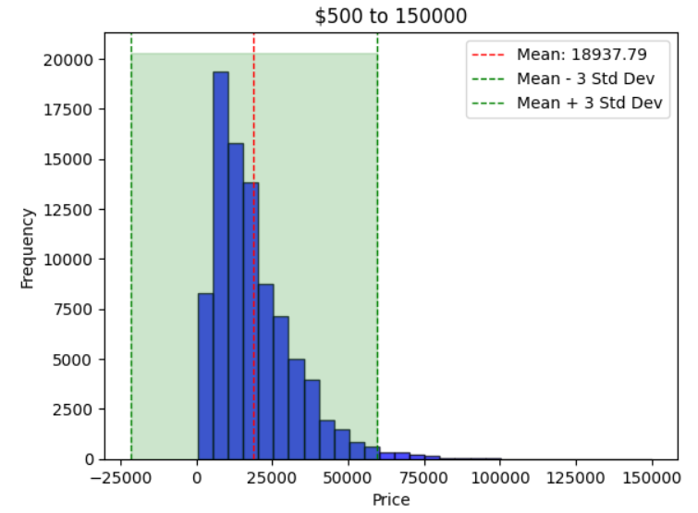
Exploratory Data Analysis
Insert Price histogram
Insert Value counts of 4,6,8 Cylinder,
Odometer histogram,
ModelYear histogram / removal

Slide 8
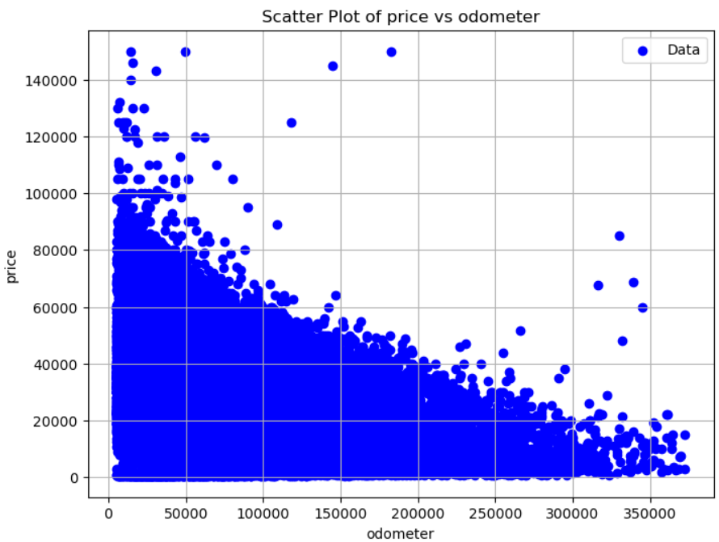
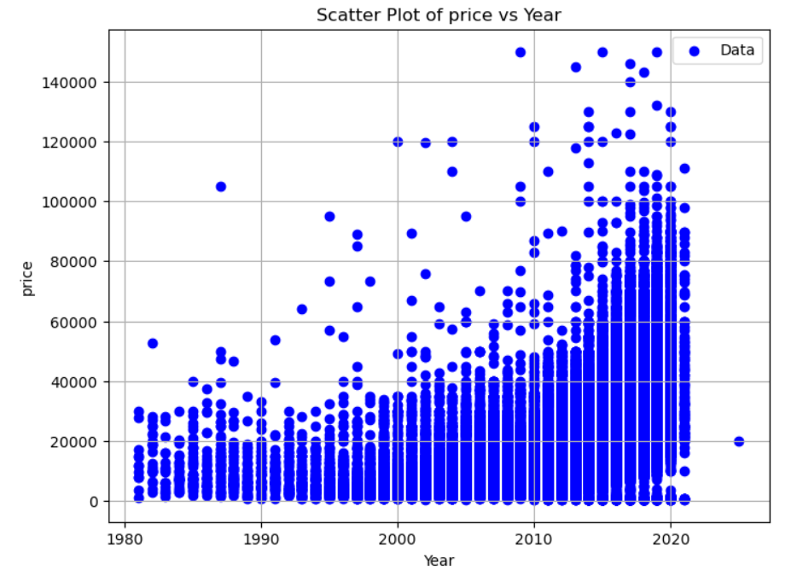
Data Problem
High-End Vehicles Listed At Low Price
TODO: get histogram of < 20k cars + year/odometer levels

Slide 9
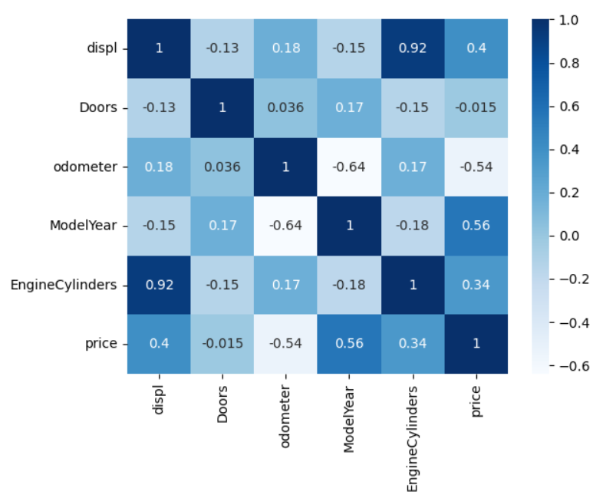
Correlations with Price (Scaled)
Price Correlations:
Model Year: 0.56
odometer: -0.54
Displ: 0.4
Cylinders : 0.34
Doors: 0.015
Collinearity:
EngineCylinders & displ: 0.92
Odometer & Model Year: -0.64

Slide 10


Data Problem #2
Limited Vehicle-Specific Information:
MSRP, Series, Trim, Add-ons
2012 Dodge Challenger
Trim | MSRP
SXT 2dr Coupe (3.6L 6cyl) 305HP | $ 25,195
R/T 2dr Coupe (5.7L 8cyl) 375HP | $ 29,995
SRT8 2dr Coupe (6.4L 8cyl) 470HP | $ 44,125
Series and Trim columns were ~50% null. Many new features, such as ‘ABS’ (anti-lock braking), were 75% null.

Slide 11
Modelling: Price Regression
Categorical Features: Turbo, Body Class, Fuel Type, Cylinders, Vehicle Type, Drive Type, GVWR, Doors, paint_color
Numeric Features: odometer, Year, displ (StandardScaler)
Target Feature: Price
Split: Train Test Split
Search: RandomizedSearch; 2 iterations
Folds: 3
Metric: RMSE
Models: LinearRegression, Ridge, Lasso, DecisionTree, RandomForest, AdaBoost, ExtraTrees, KNNRegressor, MLPRegressor, SGDRegressor, Bagging, XGBoost, LightGBM, CatBoost

Slide 12
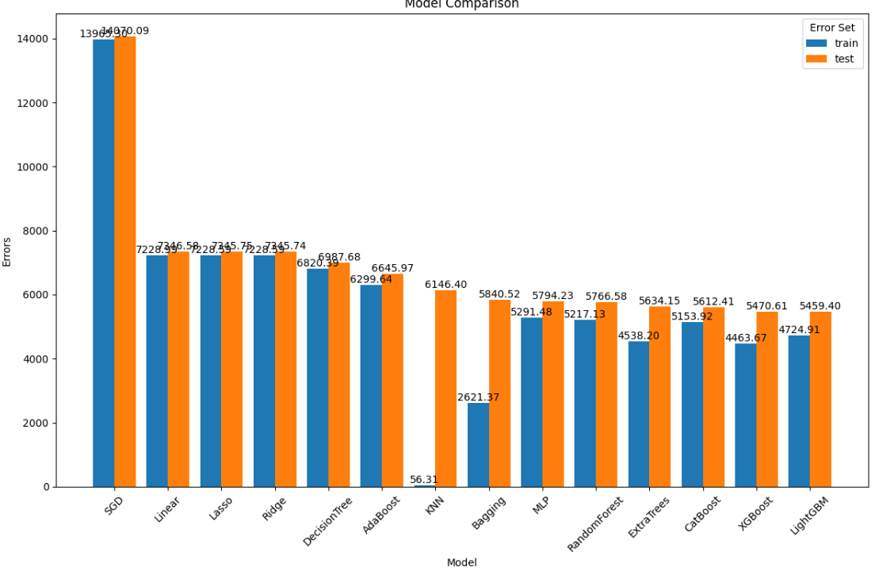

Slide 13
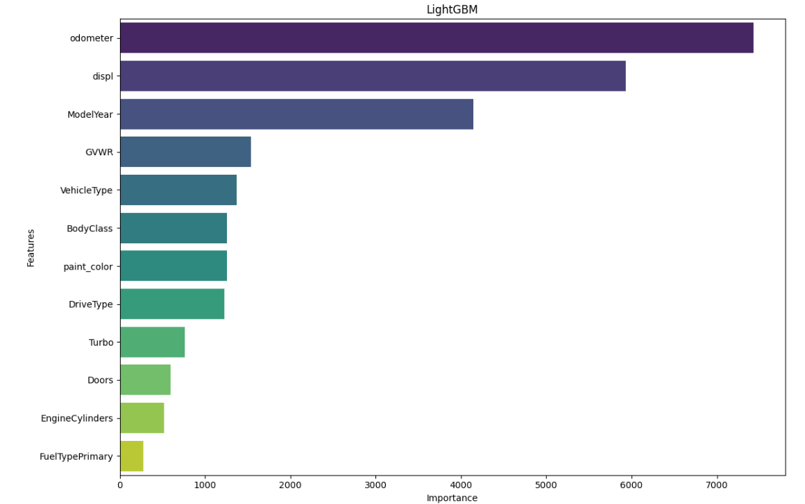

Slide 14
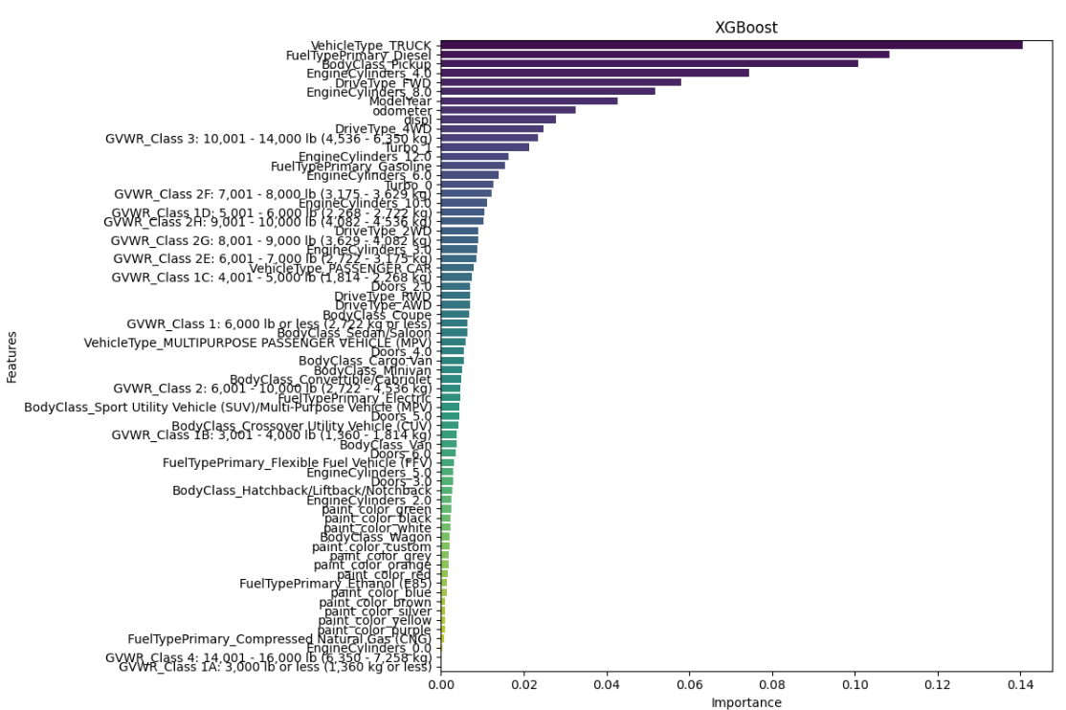

Slide 15
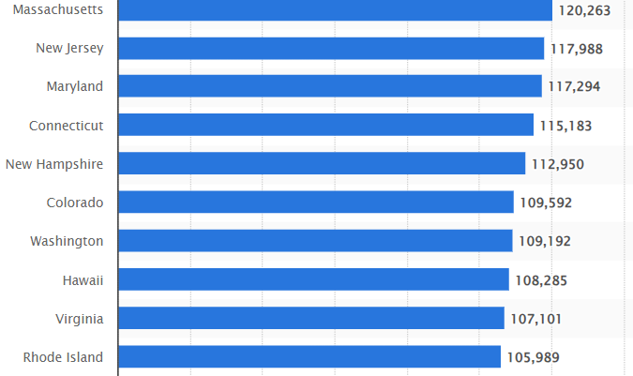
New Features
Statista: 2021 Median state Income
State, region, state_income
Make, Model, Series/Trim to find which makes and models are important to price predictions
TODO: add mean, std_dev, max,min for median state_income

Slide 16
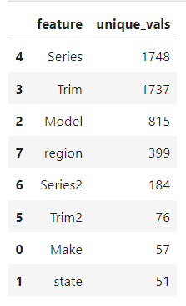
Car Identity & Regional impact on Price
These columns introduced 5,067 new features. TruncatedSVD is used to ‘squash’ the variance of these features into a set number of components
Tested with or without these features to answer two questions:
Does state/region & local economic factors play a role in vehicle prices?
Do some makes/models have higher price point despite identical values for: displ, EngineCylinders, BodyClass, Year?

Slide 17
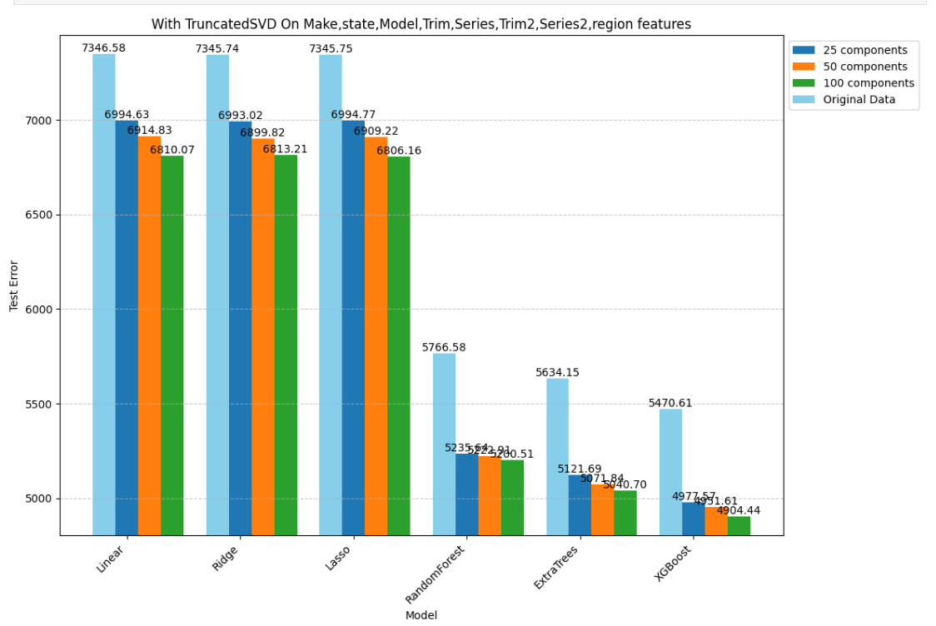

Slide 18
Final Models: CatBoost & LightGBM
These two models do not require dummy variable encoding.
CatBoost finds the relationship between categorical variables using integer encoding, which has proven upsides.
LightGBM performs feature selection within the training process. These are naturally a good fit for the dataset which has a large number of sparse, inconsistent categorical variables.

Slide 19
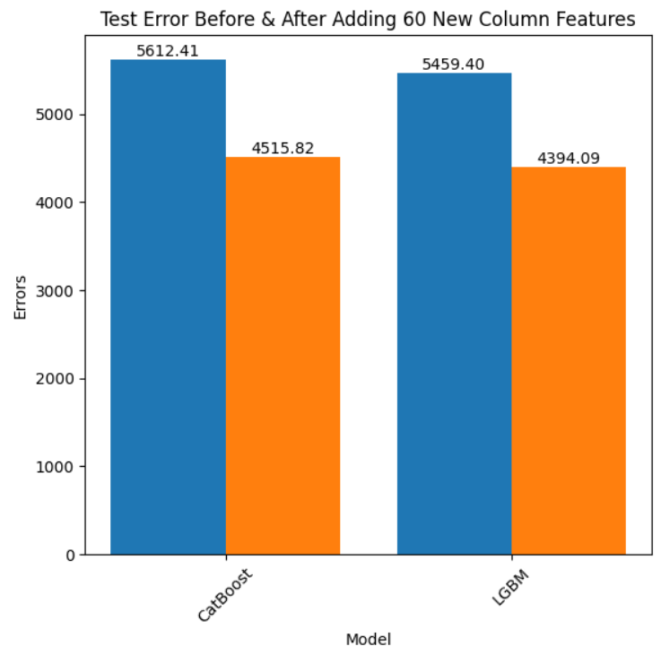
List Features: ABS, etc.

Slide 20
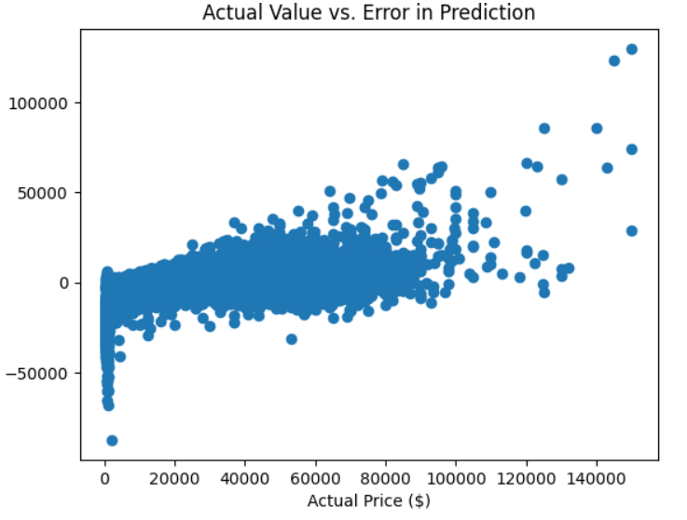
Residual Analysis

Slide 21
Leverage Point #1: Outlier Percentage Error
3 Standard Deviation in % Error
Mean % Error: -27.83%
STD % Error: 327%
Number of Listings > 3 Standard Deviations From Mean: 538 rows
Odometer-year-price Threshold: 708 rows
Odometer < 120,000 ModelYear > 2008 & Price <= $2500
Overlap: 523 rows
Removing Overlap: ‘3STD’ dataframe

Slide 22
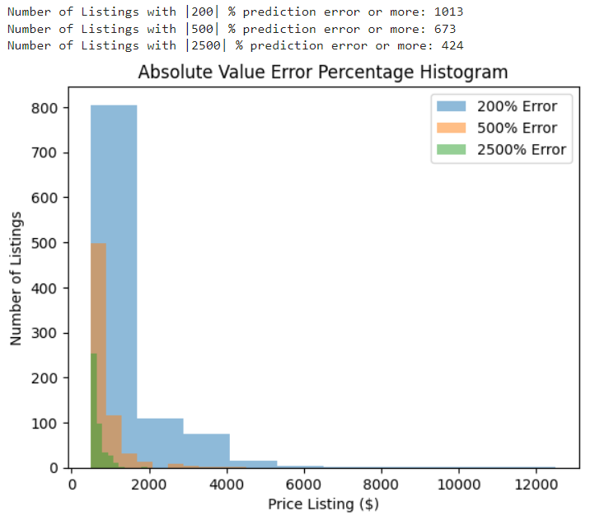
Leverage Point #2:
Absolute Percentage Error

Slide 23
Leverage Point #3: Manual Removal
Manually inspecting the ‘description’ column of the highest percentage errors
4 Categories of Large Errors:
Down Payment listed in Price
‘$300 Down’
Damaged/Inoperable Vehicles
‘For Parts’, ‘As-Is’, ‘Doesn’t Run’, ‘Mechanic Special’
‘Souped Up’ Vehicles
Lists of Car Parts and Dollar Values ‘{Car Part} ($600)’, ‘Engine Rebuilt’,
Cargo Vans
Liveable, highly variable in rate of depreciation; Minority of Dataset

Slide 24
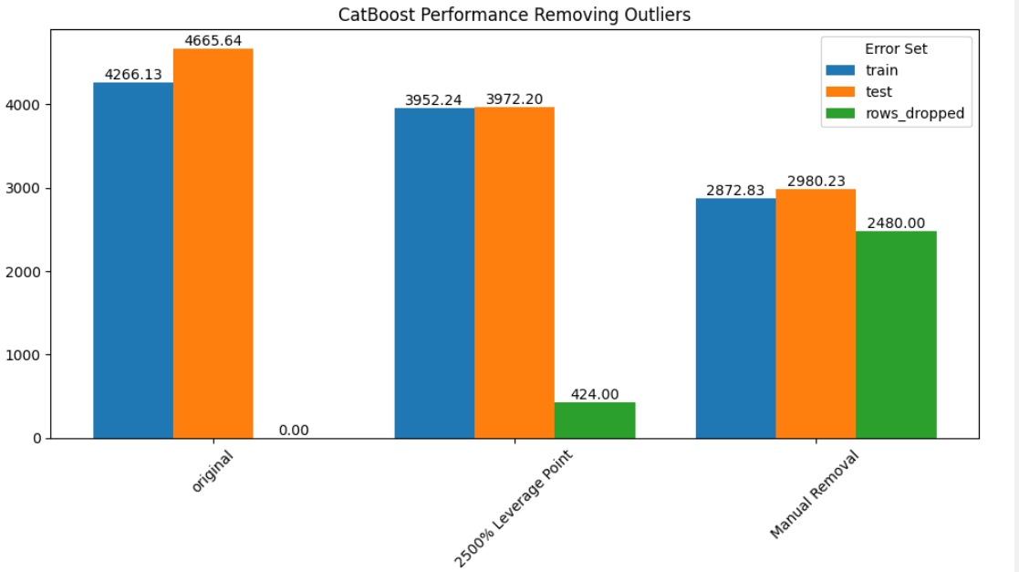

Slide 25
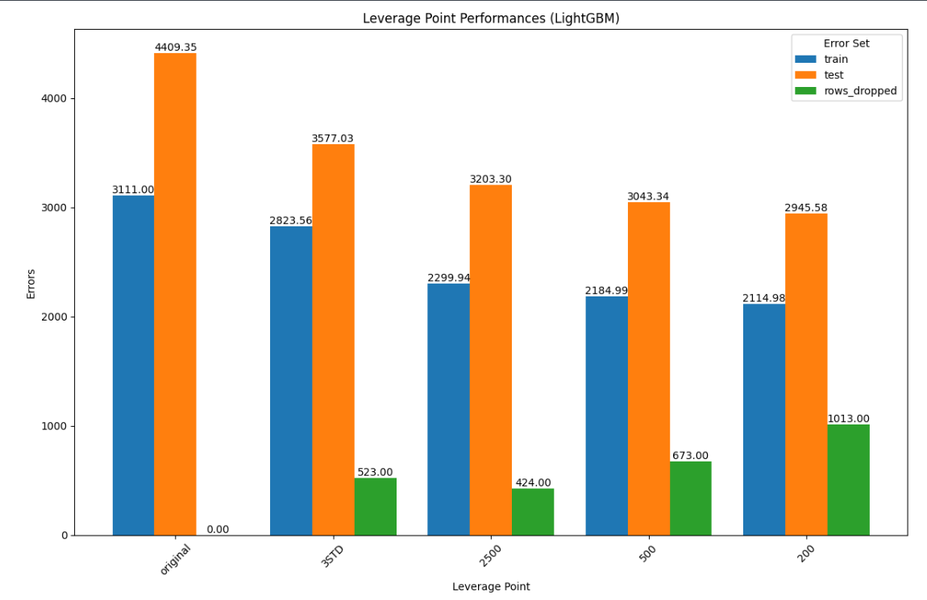

Slide 26
Leverage Point 4: $5000+
Number of Rows < $5001: 8021
Pros:
Removes Most ‘Down Payment’ & Broken Vehicles
Most Vehicles Above $50,000 are a small percentage of data and can be considered outliers
Cons:
Loses some predictive ability of lower and higher end vehicles
Doesn’t discern between spam and non-spam
TODO: plot dataframe length, results

Slide 27
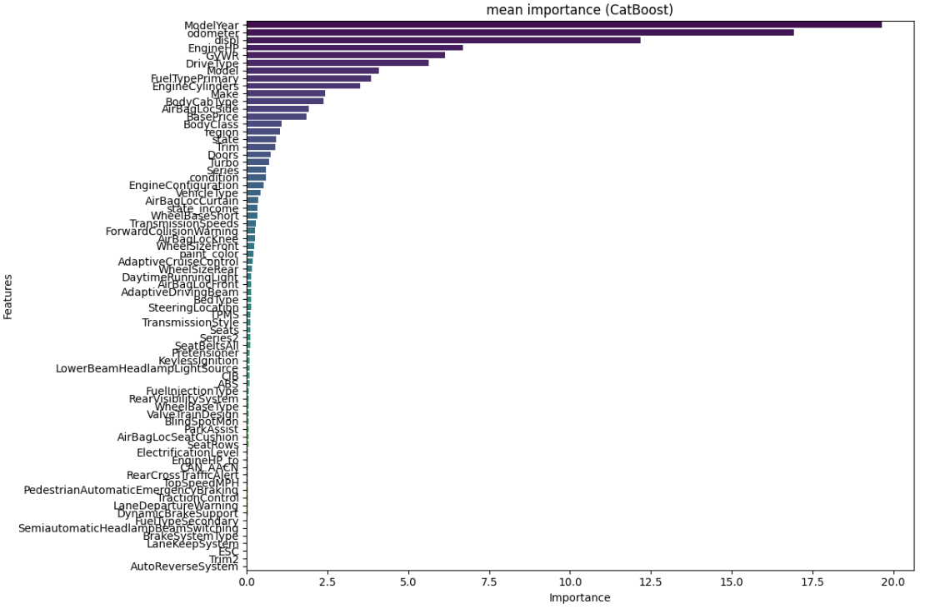

Slide 28
Top 10 Overall Features | Importance
Traction Control: Standard | 0.1523
Rear Visibility System: Standard | 0.0674
Semiautomatic Headlamp Beam Switching: Standard | 0.0522
Body Cab Type: Crew/SuperCrew/CrewMax | 0.0500
ESC: Standard | 0.0401
Body Class: Pickup | 0.0251
Fuel Type Primary: Diesel | 0.0257
Engine Cylinders | 0.0186
VehicleType: Truck | 0.0120
Day TimeRunning Light: Standard | 0.0120

Slide 29
Top 5 Makes | Importance
Porsche | 0.003383
Jeep | 0.002809
Land Rover | 0.002344
Mercedes-Benz | 0.001840
RAM | 0.001834
Top 5 Models | Importance
Porsche 911 | 0.005904
Jeep Wrangler | 0.004085
Acura TLX | 0.003151
GMC Sierra HD | 0.002492
Cadillac XT6 | 0.002194

Slide 30
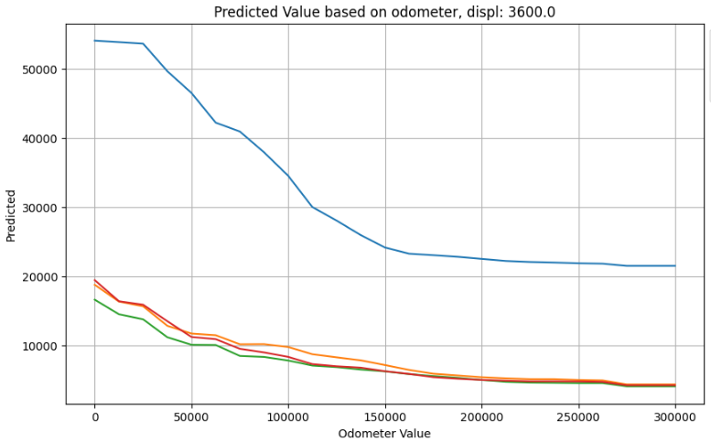

Depreciation: 2005 Porsche 911
MSRP
Infiniti G35 $30,700
Porsche 911 $83,400

Slide 31
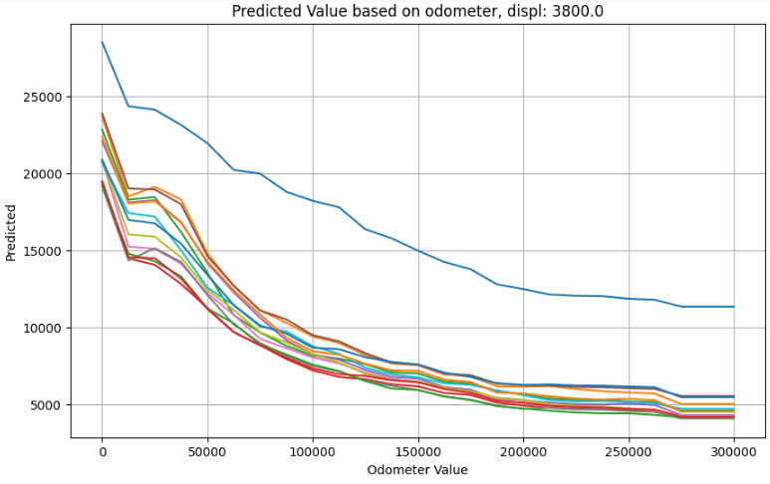
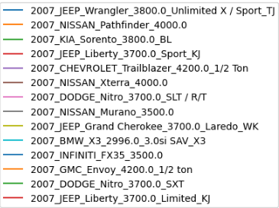
Depreciation: 2007 Jeep Wrangler
MSRP
Wrangler: $22,530
Pathfinder: $27,000

Slide 32
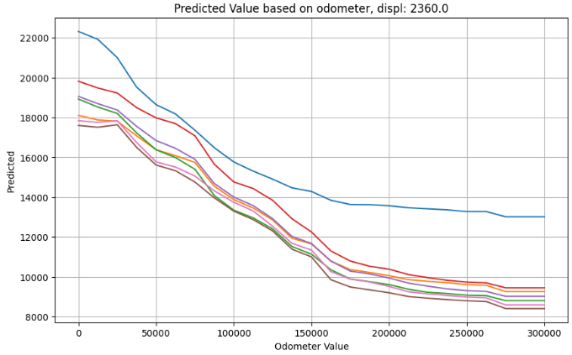
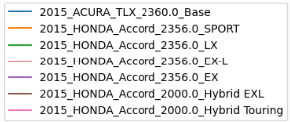
Depreciation: 2015 Acura TLX (V4)
MSRP
Accord EX-L: $28,400
TLX: $31,450

Slide 33
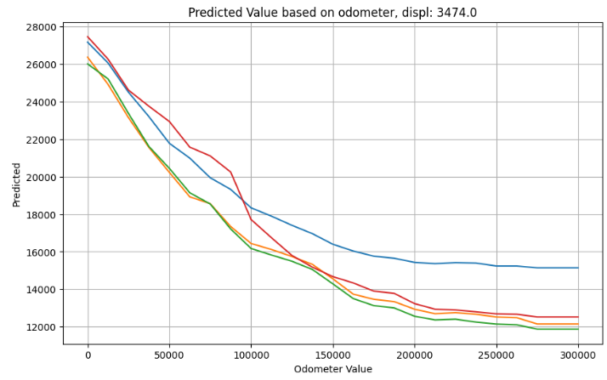

Depreciation: 2015 Acura TLX (V6)
MSRP
TLX: $35,320
RLX: $48,450

Slide 34
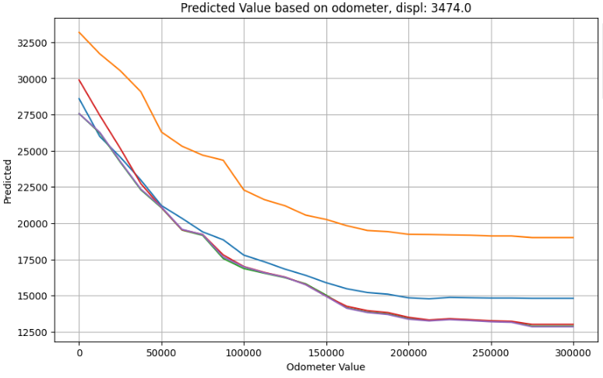

Depreciation: 2016 Acura TLX (V6)
MSRP:
Accord EX-L: $30,740
TLX Advance: $42,600
RLX Tech: $54,450

Slide 35
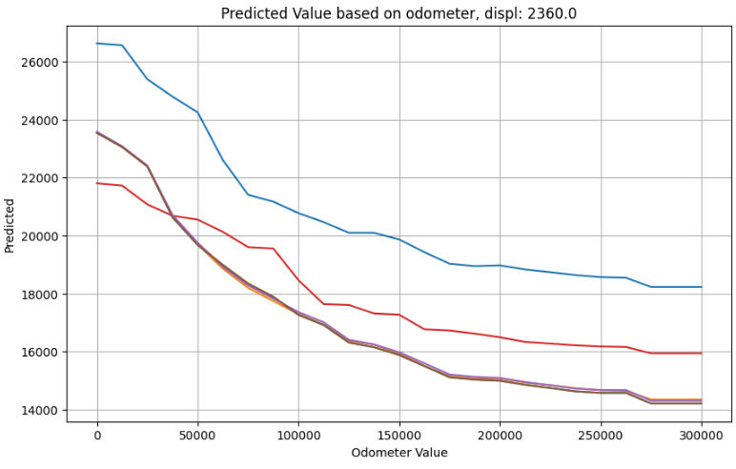
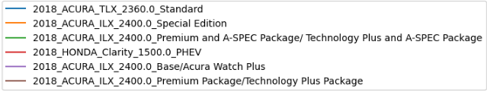
Depreciation: 2018 Acura TLX (V4)
MSRP:
TLX: $33,000
ILX: $28,100
Clarity: $33,400

Slide 36
Future Work
Data Cleaning: Series/Trim Values
In addition to providing information in itself, Series/Trim can be used to obtain new features by…
Data Scraping: Edmunds, KBB
MSRP
Fuel Economy
Horsepower & Torque
Towing Capacity
Safety/Luxury Features
NHTSA API
Crash Ratings, Recalls, Investigations, Complaints
CI/CD Pipeline:
Spam Detection
Automated API Lookup: Cleaning up Output, Imputing Missing Values

Slide 37
Future Work
Use State, latitude/longitude, and Region columns:
add local factors such as climate (trucks for snow vs. convertibles), economic factors: consumer prices & income level, level of local sprawl/driving demand
Use displ and Model columns to:
Impute: gas mileage, horsepower, Series/Trim, Turbo, Interior Upgrades
Use Make, Model, Series, Trim, Year:
Impute missing safety or luxury features such as Antilock Braking systems

